Slide 1
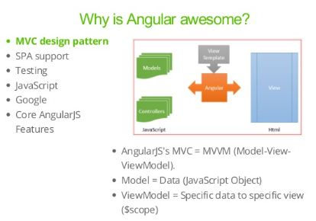

Slide 2
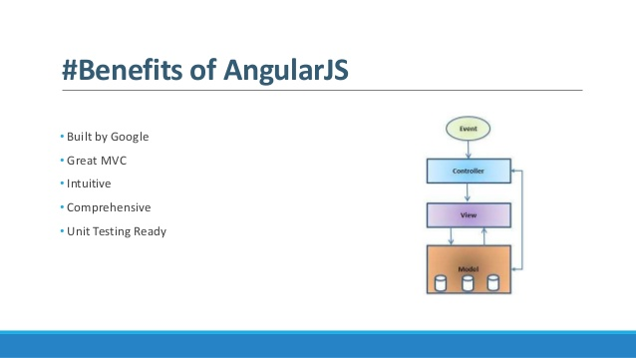

Slide 3
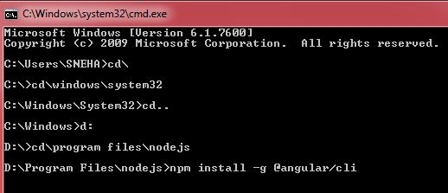

Slide 4
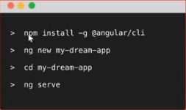
Installation to Execution

Slide 5
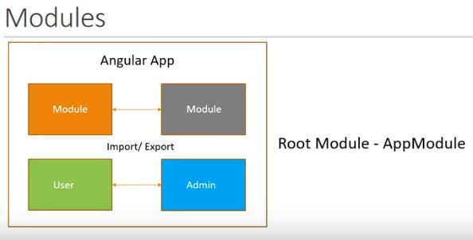

Slide 6
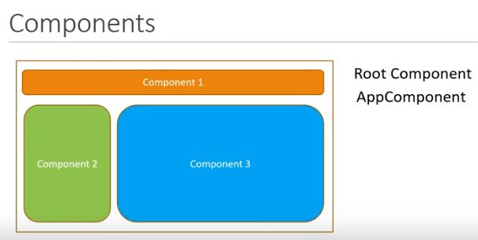

Slide 7
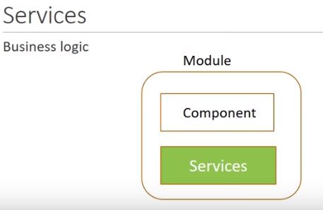

Slide 8
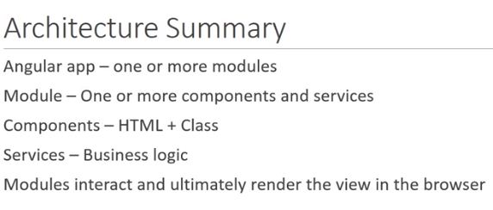

Slide 9
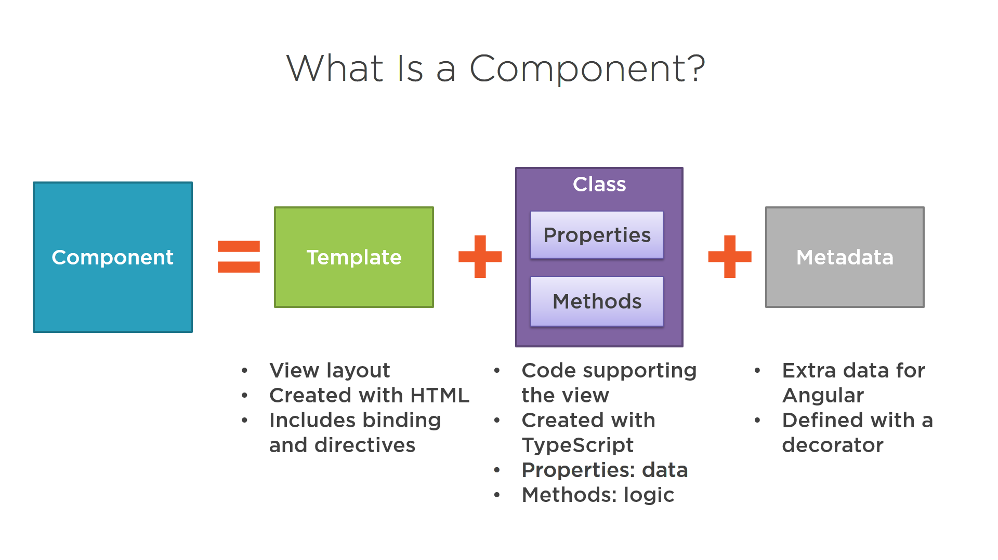

Slide 10
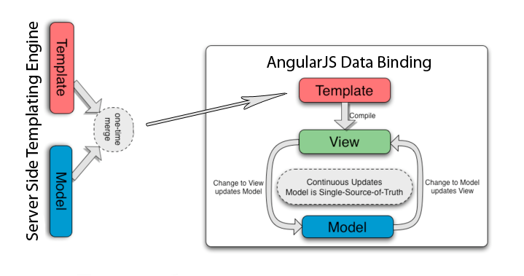
Binding in Angular

Slide 11
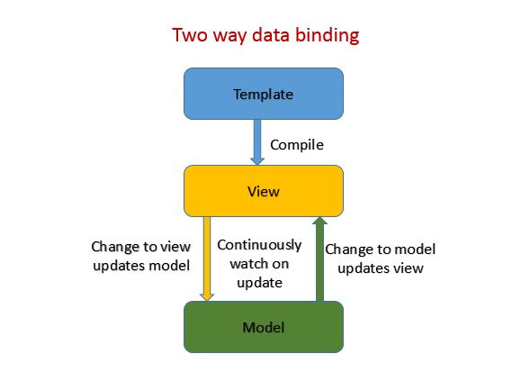

Slide 12
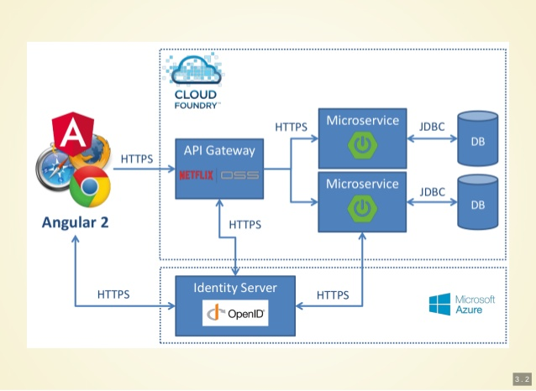

Slide 13
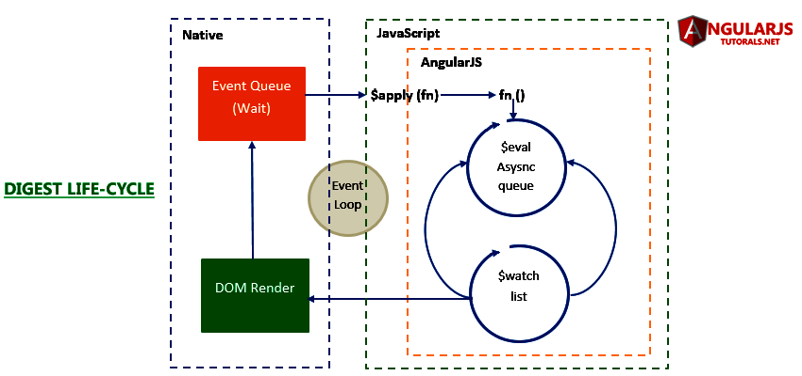

Slide 14
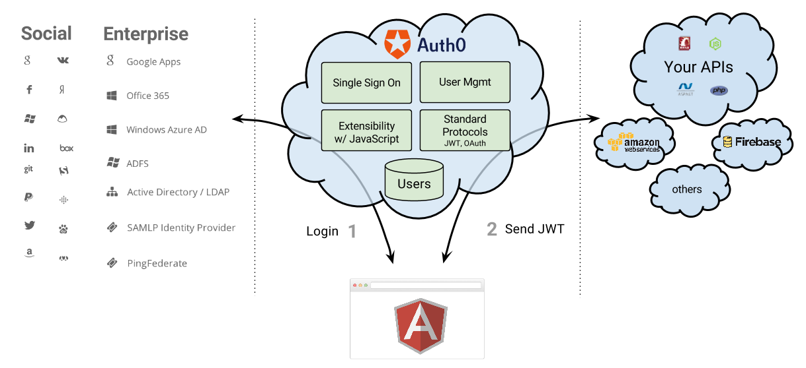

Slide 15
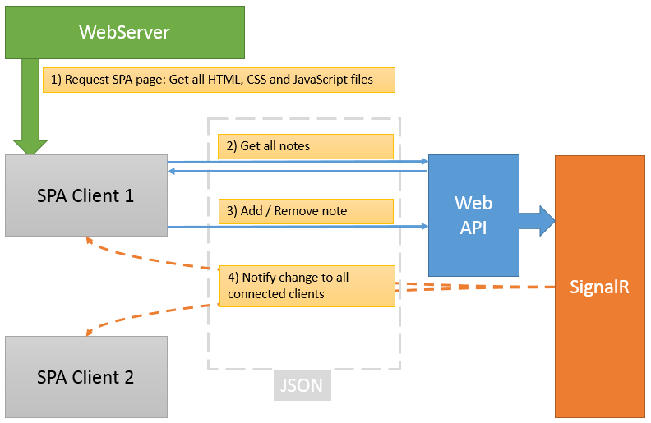

Slide 16
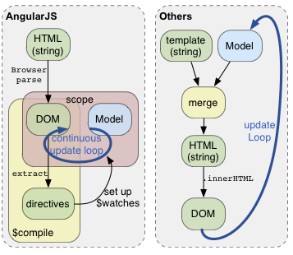

Slide 17
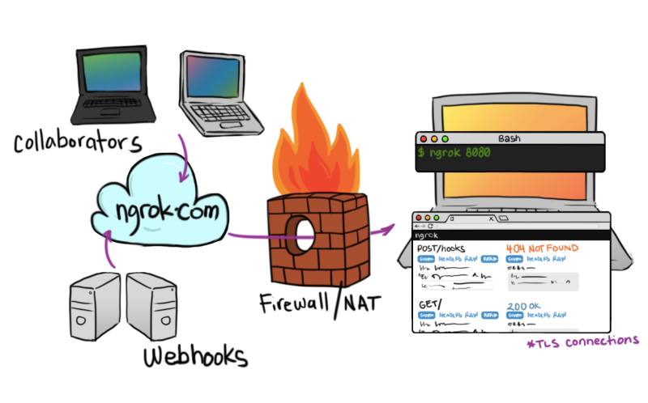

Slide 18
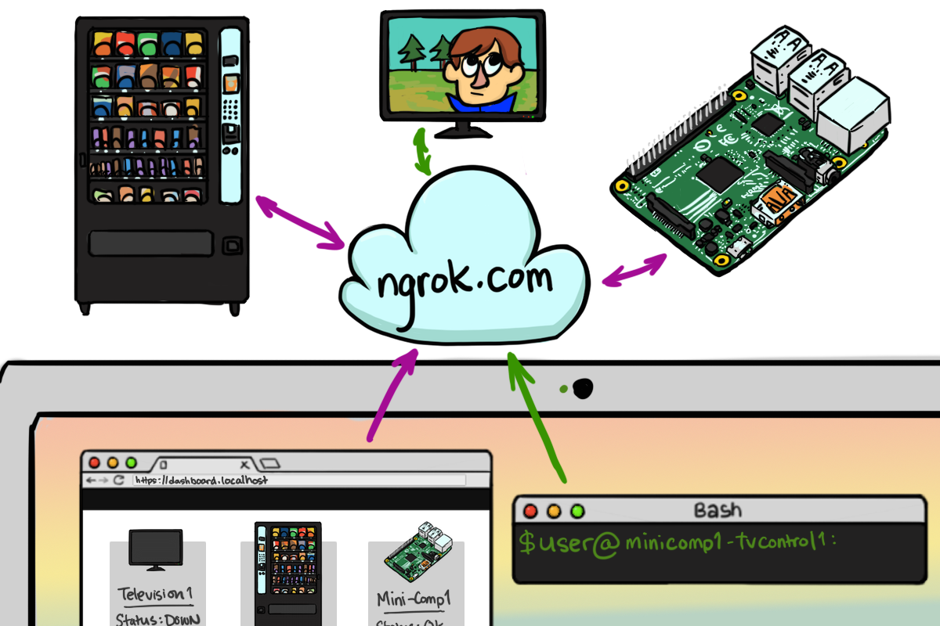

Slide 19

CRUD APPLICATION
App Structure
Start with Firebase DB
Generate API there
Get into root of the new file
Use npm i - -s firebase @angular/fire
Env.ts file connect the API of Firebase

Slide 20
ng new ANGULAR7CRUD

Slide 21
Environment.ts for API
App.module.ts for es6

Slide 22
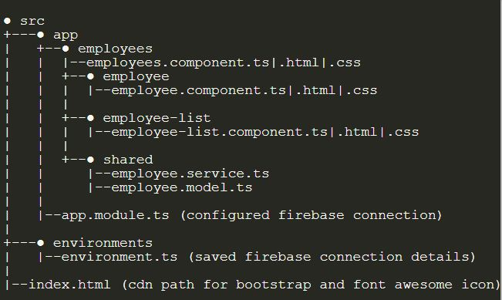

Slide 23
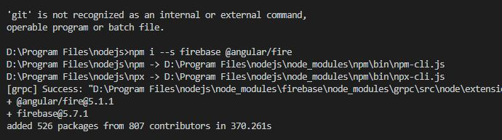

Slide 24
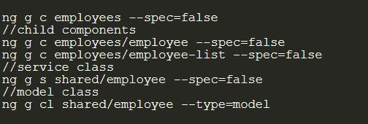

Slide 25
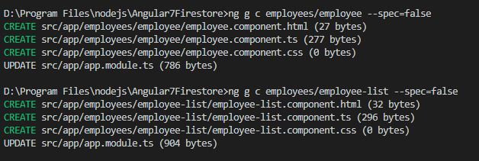

Slide 26
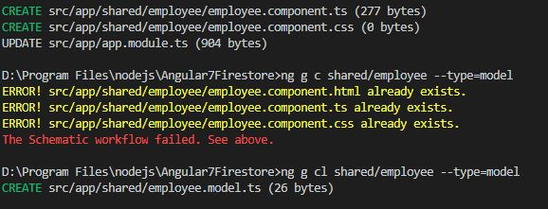

Slide 27
Src/app/app.component.html
Html web page customization
<div class="container">
<app-employees></app-employees>
</div>

Slide 28
Src/app/employees/employees.component.html

Slide 29
Src/app/shared/employee.model.ts
export class Employee {
id: string;
fullName: string;
position: string;
mobile: string;
}

Slide 30
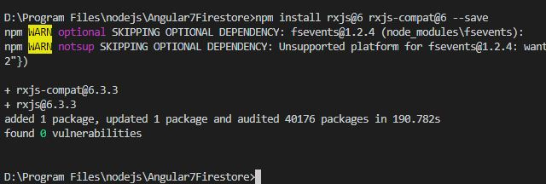
For error compilation at run time
npm install rxjs@6 rxjs-compat@6 –save
npm install --save angularfire2@5.0.0-rc.7
npm i -–s firebase @angular/fire

Slide 31
CRUD APPLICATION
npm uninstall @angular/cli -g npm install @angular/cli –g
ng new sb-app --skip-git
npm cache verify
Npm i --s firebase @angular/fire

Slide 32
Command Create component

